Slide 1
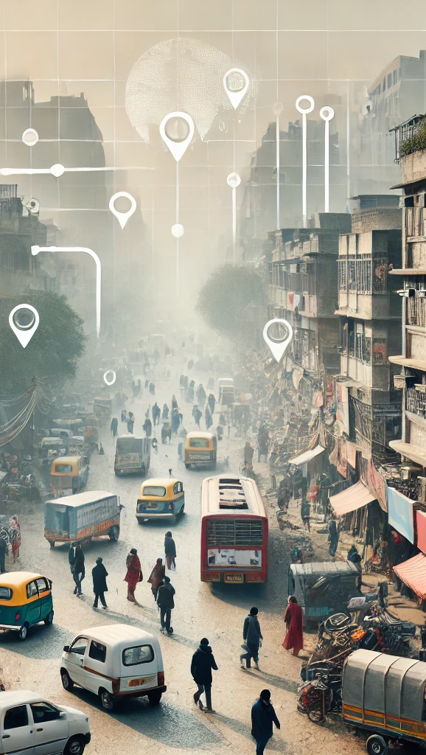
PROJECT AIRNODE: AIR QUALITY AND IMPACTING FACTORS

Slide 2
Objective
To visualize the air quality in major cities of India and showcase the change in pollution, particularly focusing on PM2.5 levels.
Emphasize the importance of monitoring air pollution to improve community health and decision-making.

Slide 3
SIGNIFICANCE
KEY STAKEHOLDERS:
Local Communities
Researchers & Academics
Government & NGO’s
General Public
RELEVANCE:
Real–time insights into air quality patterns
Helps identify pollution hotspots
AI-based predictions for better planning

Slide 4
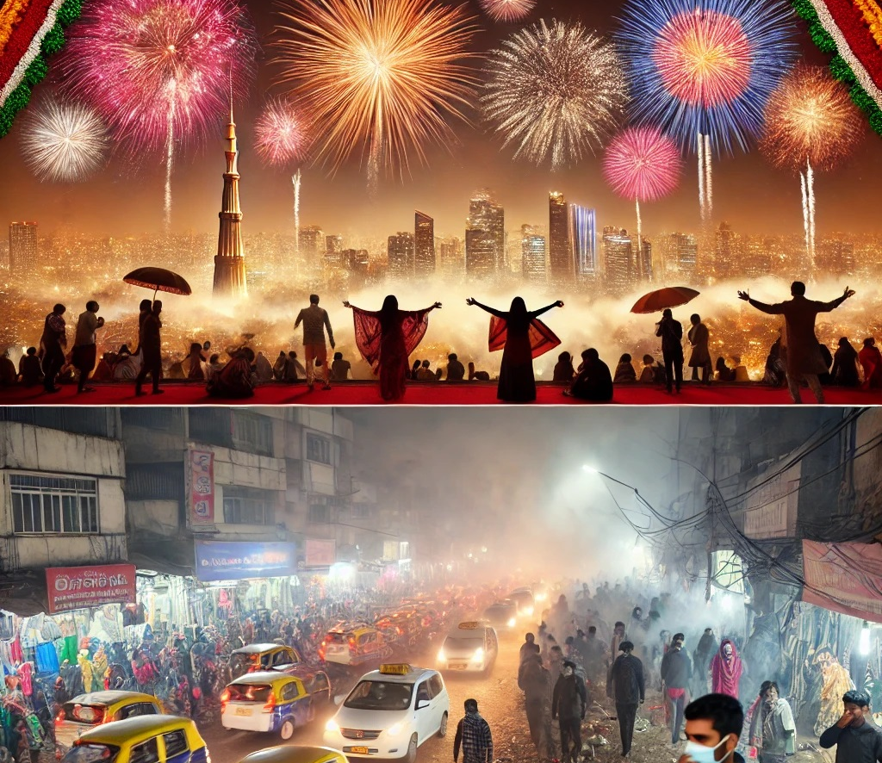
Diwali CELEBRATION & Air Quality impact on Communities
Health Impacts:
Increased respiratory issues, especially in children and the elderly.
Economic Impact:
The rise in healthcare costs and lost productivity due to poor air quality.

Slide 5
Feature overview
Time Series Dashboard:
Visualizes PM 2.5 air quality data (2019-2023) for Indian cities
Enables users to view monthly variations in air quality
AI- Driven Predictions:
Predicted air quality in Chennai using LSTM and CNN algorithms
Helps forecast pollution patterns and provides early warnings

Slide 6
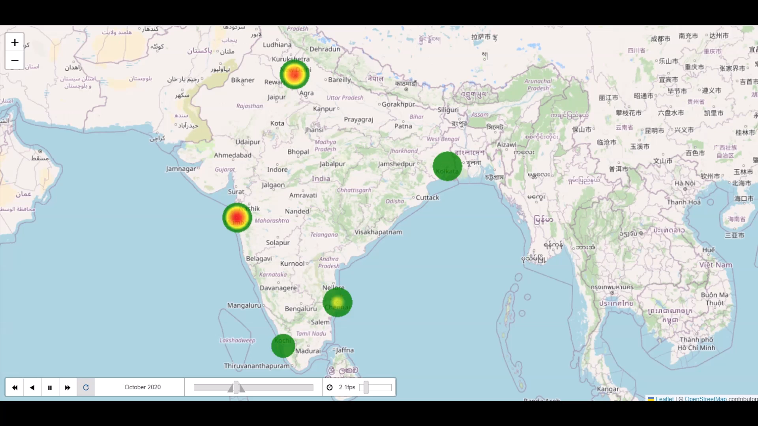

DIWALI AIR quality - HEATMAPs
DIWALI 2020
DIWALI 2022

Slide 7

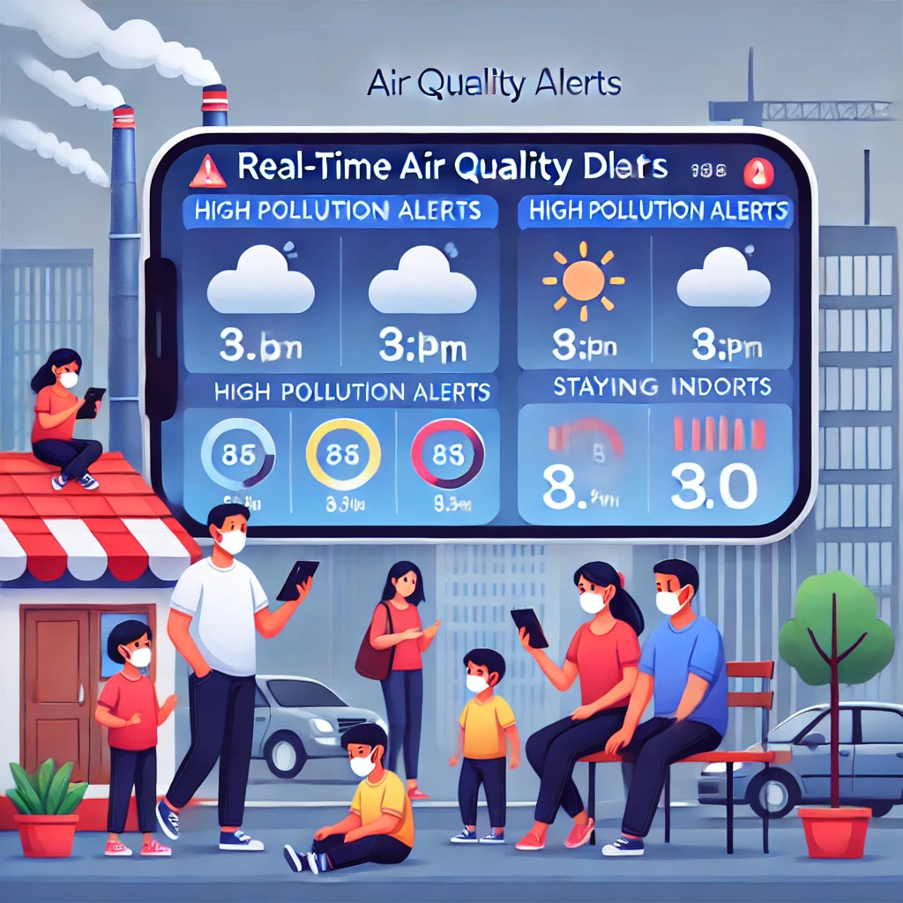
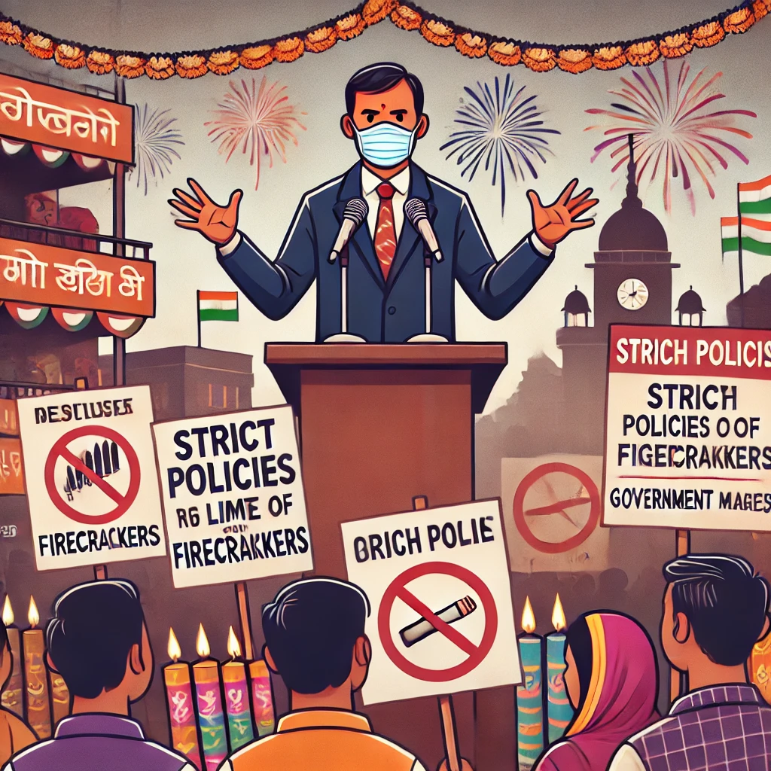
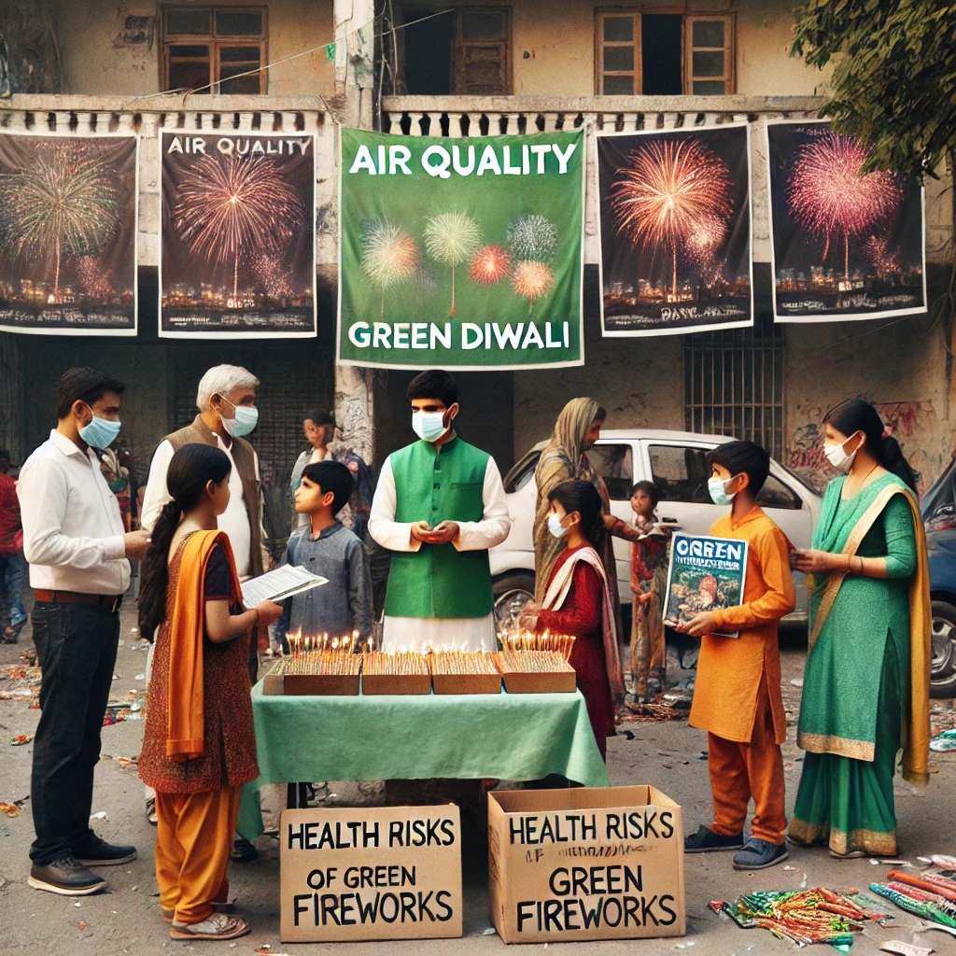
FOR BETTER COMMUNITY & BETTER LIFE
GOVERNMENT
POLICY MEASURES
ECO DIWALI
REAL TIME ALERTS
CAMPAIGNS

Slide 8
FUTURE WORK
AI Predictions – Improvement:
Increase continuous satellite data integration
Real time monitoring and time series prediction of pollution hike
Develop real time mobile alerts
Focus on different pollutants to find more accurate solutions
Time series Dashboard:
Air Pollution Alerts when over Specific PM2.5 limit value
Leaflet in a story format for citizens to influence decisions

Slide 9
THANK YOU!

